Slide 1
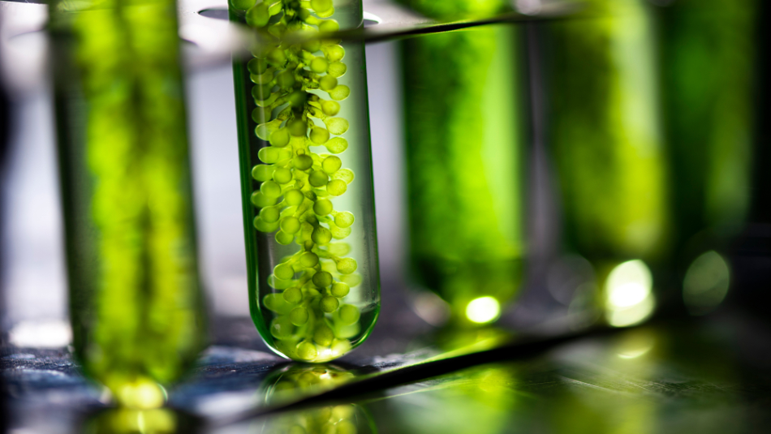

BUSA649 FINAL SOLUTION
Summit View Development Corp (SVDC)
Yichen Wang (260761601)

Slide 2
Strategy
At what algae solution density level should we harvest? (density level)
For each harvest, how much solution containing algae should we collect? (volume)
How long should it be between each harvest (time)
Harvesting scheme
(appendix A1.1)
Value proposition (appendix A1.2.1)
Pain point: SVDC looks for a more reliable way to interpret all the data collected manually from experiments, to draw conclusions about the more efficient and profitable algae harvesting scheme. The potential solution aims at suggesting the most efficient harvesting scheme, leading to a higher yield and potentially lower the production cost.
Decision support: expected mass calculated from theoretical harvesting scheme
Quantitative value: theoretically improved the current harvesting scheme by 550%, leading to an estimate of $30800 increase in profit for every 1000L photobioreactor.
Qualitative value: Prepared data convenient for the modelling and dashboards through easy-to-understand tables in the warehouse. Monte Carlo model is available for future tuning as well.
External Data (appendix A1.2.2)
Purpose: better estimate the profit made because profit is a more reasonable KPI compared to mass harvested per year
External Data taken from Alibaba (find prices for reference, as well as the estimation of cost for each harvesting pump use)

Slide 3
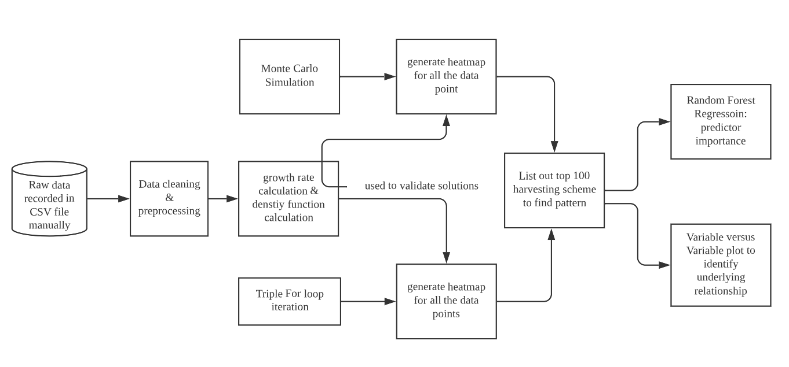
Architecture
Recommendation:
1. Daily updated laboratory data taken manually could be uploaded to cloud data warehouse such as Google Cloud Platform so data analysis could be easily done using Google BigQuery.
2. Laboratory data should be taken with norm, and should avoid irregular interference in the data, which could lead to unreliable analysis (Garbage in, garbage out)

Slide 4


data processing
Modeling
Manually recorded dataset
From 2020 to 2022, take the density level of algae in photobioreactor (PBR) on a daily basis
Many technical mistakes due to operation errors, leading to some outliers.
Simulate the density vs time plot for the entire growth period without external interference
Estimated by ployfit provided by numpy using Python.
Data Source: PBR1
(Appendix C.1.1)
Growth process visualization
data cleaning
data plotting
data selection
growth rate calculation
Function simplification
Final function simulation
remove nulls and outliers due to experimental mistakes.
plot daily recorded density vs time
select the growth period that is not affected by the experiments.
(Appendix C.1.2)
calculate the rate of growth per minute based on selected growth cycle.
(Appendix C.1.3)
use step function to simplify the growth rate function.
(Appendix C.1.4)
use piecewise function to simulate the entire growth process
(Appendix C.1.5)

Slide 5
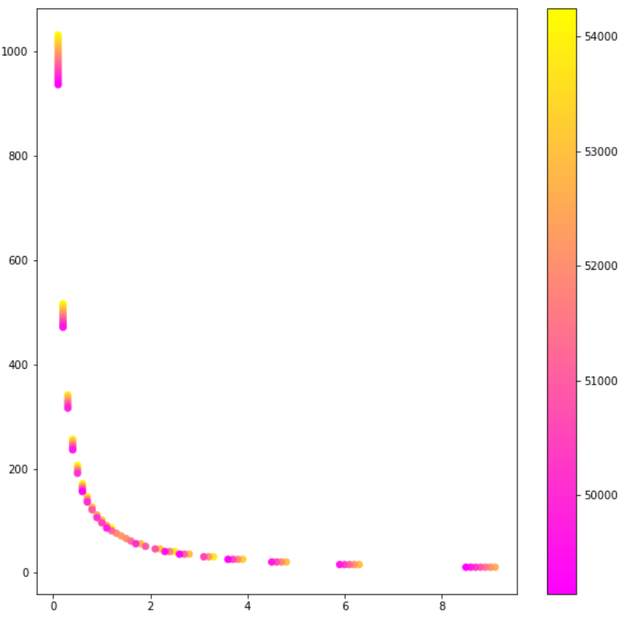
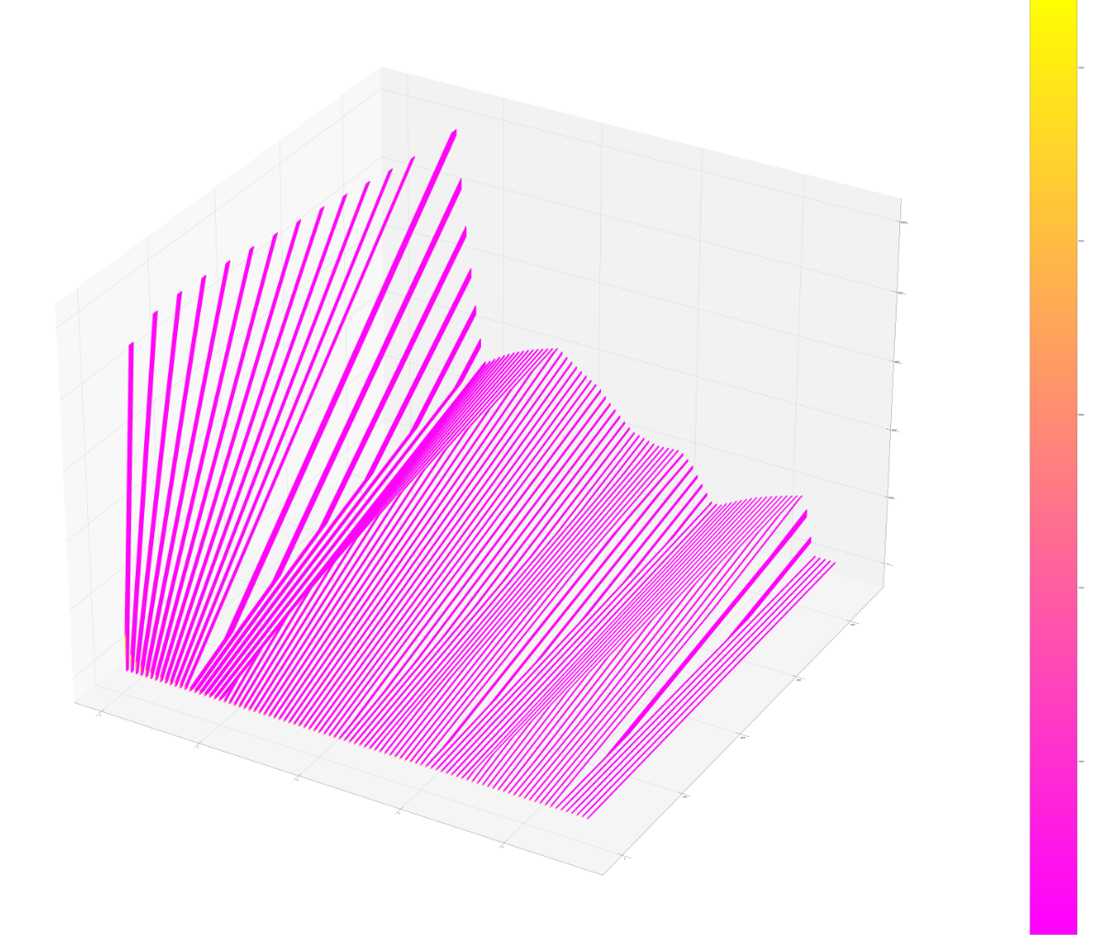
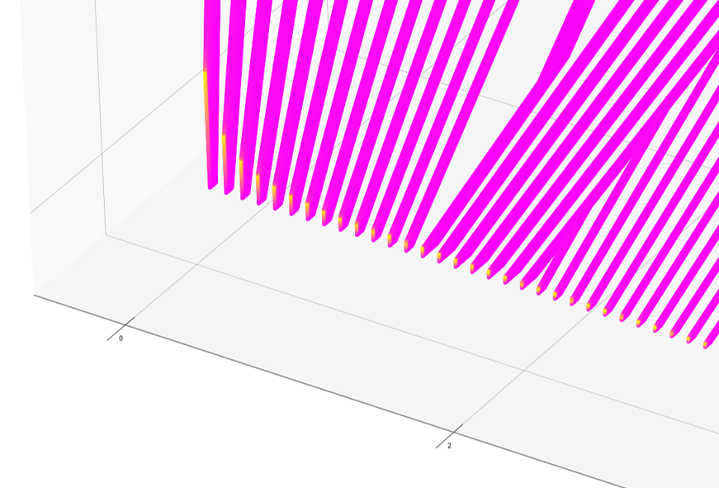
Optimization Model: Heatmap method
Conclusion:
1. By harvesting as frequently as possible (here is minimal 1min interval between each harvest) could lead to theoretical maximum yield.
2. Despite of different growth rate at different density level, there’s an inversely proportional relationship between density and volume extracted. However, most of the successful harvesting schemes concentrate between density = 1g/L and 3g/L
Perform iteration between possible ranges for each variables.
Density level of algae p: 0.50g/L to 10.00g/L, minimal interval = 0.01g/L
Time between each interval t: 1min to 4320min (3 days), minimal interval = 1min
Volume extracted for each harvest v: 0.1ml to 10000.0ml (10L), minimal interval = 0.1ml
Mass harvested in an year m = p*v*(365*1440/t) [number of harvests in a year]
When listing the top 100 harvesting schemes (all with harvest interval = 1min), there is an inversely proportional relationship between Volume extracted (on y-axis) and Density (on x-axis), with color indicating the mass of algae harvested for one year.
A three dimensional heatmap with density, time and volume (variables) on x, y, z axis and mass harvested for an year indicate the color of the heatmap.
Only a tiny yellow color is shown at low t value (yellow represents high algae yield). This means that only harvesting very frequently (harvest every 1 min) can leads to maximum yield. (Appendix C.2.1)

Slide 6
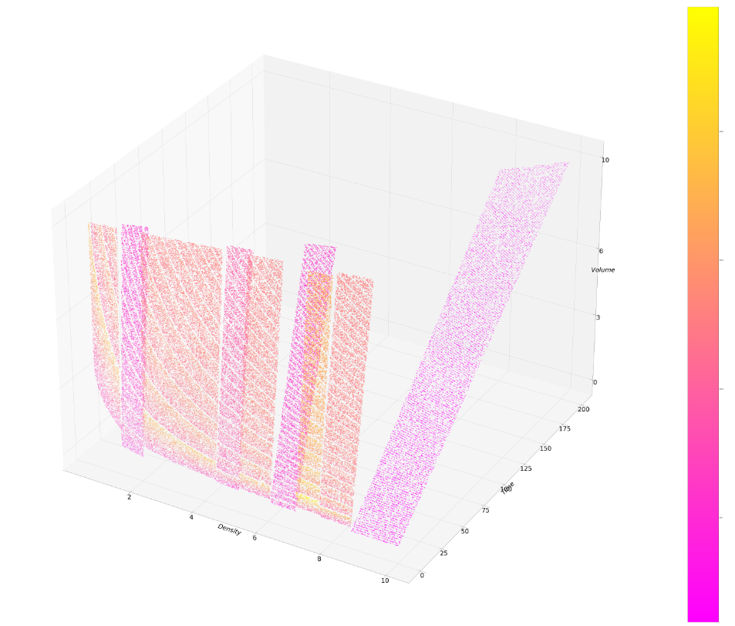
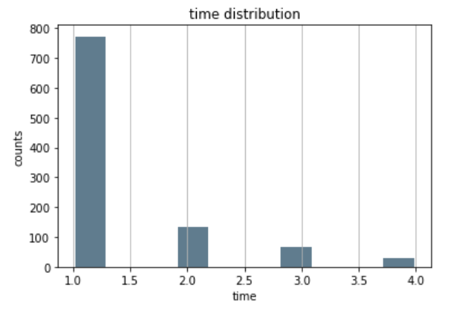
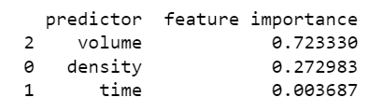
Optimization Model: Monte Carlo method
Randomly generate dataset based on probability distribution preferred (normal distribution in this case), and find the best combination of harvesting factors.
Same range as previous iteration heatmap method
Use 100000 data points to mimic the whole simulation
Conclusion:
The 100000 data points contribute to this heatmap, which proves the conclusion of the previous method. At low t values (short time intervals), there is an inversely proportional relationship between density and volume. It is also interesting to see that at around density = 8g/L, the average yield is higher than other density levels. It is because the growth rate at 8g/L reaches the highest, which explains the situation. (See appendix C.1.4)
By doing a random forest regression (appendix C.3.1) on the mass harvested, volume has a higher importance than all the other predictors, whereas time is the least influential factor, as it only ranges between low values, as shown in the distribution histogram below:
The 100000 data points contribute to this heatmap, which proves the conclusion of the previous method. At low t values (short time intervals), there is an inversely proportional relationship between density and volume.

Slide 7
Heatmap method vs. Monte Carlo method
Heatmap:
Advantage
1.includes all the possibilities, results more inclusive and reliable
2.very understandable, find the optimal solution using brute force algorithm.
Disadvantage
1.very computationally expensive, took 11 hours to run for a single iteration. (complexity of O(n^3))
2.difficult to identify useful part of the heatmap as we only look into the high-yield harvest scheme, represented by the yellow area in the heatmap.
Monte Carlo:
Advantage
1. much less computationally-expensive, took 15s for generating solution dataset
2. can adjust probability distribution for each factor. (e.g. generate density with a distribution of 0.5-3 g/L (20%), 3 - 6g/L (60%), 6-10 g/L(20%))
3. can generate a heatmap with less dense data points, hence could find the details more clearly.
Disadvantage
1. solutions generated randomly may miss the optimal combination, less reliable.

Slide 8
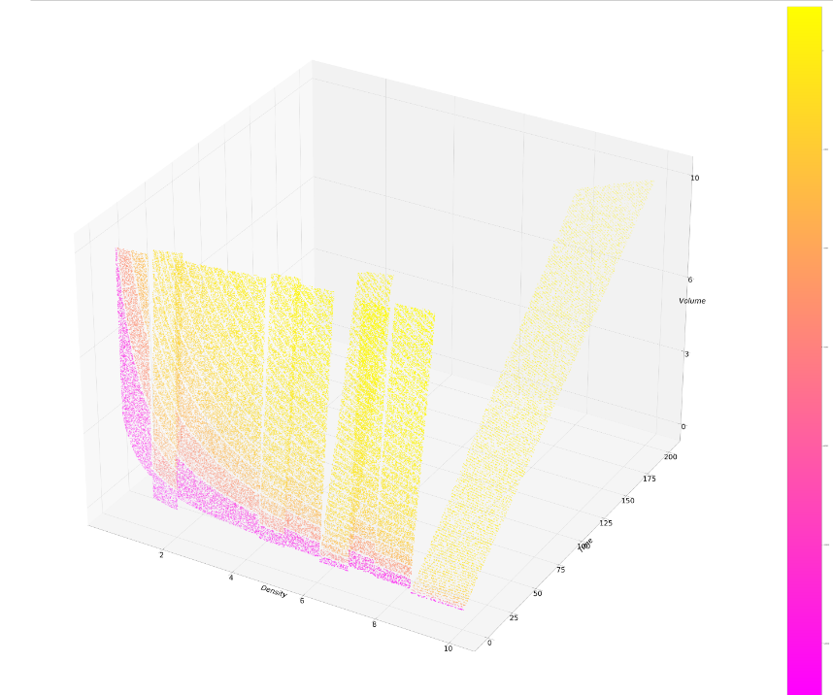
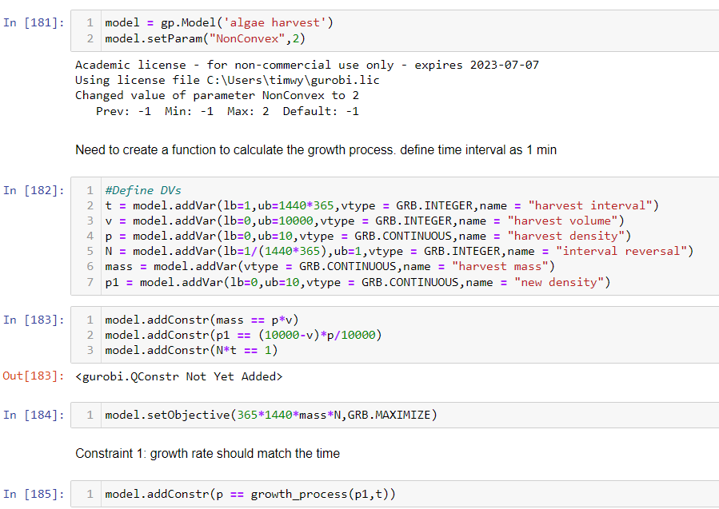
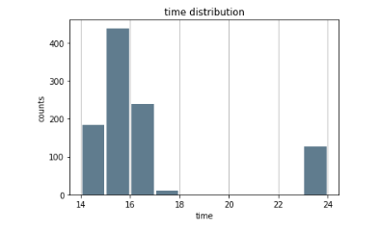
Improvements
Assumption: there is no cost for each harvest (required by SVDC)
This leads to no restriction on number of harvests. (Main cause of why most solutions suggest harvest at the minimal time interval, t = 1min)
Improvement: introduce cost and profit
Price = $0.007/g, cost = $0.25
Metric changed into total profit made instead of mass harvested in one year.
More frequent harvests will result in a penalty for a high harvesting cost, leading to lower profit.
Monte Carlo Method: (Appendix C.4.1)
Price = $0.007/g, cost = $0.25
Changed heatmap generated compared to no cost for each harvest.
Time between each harvest increases dramatically, and has a greater variation
Gurobi Optimization Method:
Since Gurobi can only handle 2-variable optimization, 3-variable situation is more tricky, requires substitution.
Cannot use pre-defined functions which takes variables, restricting the performance, and less understandable.

Slide 9
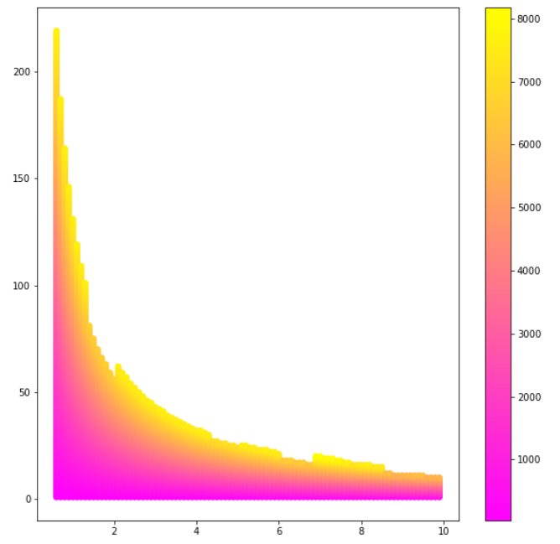
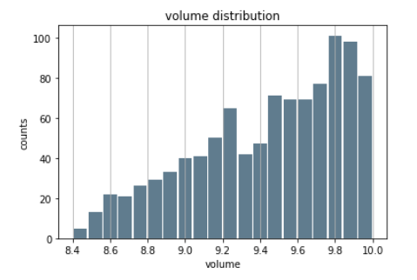
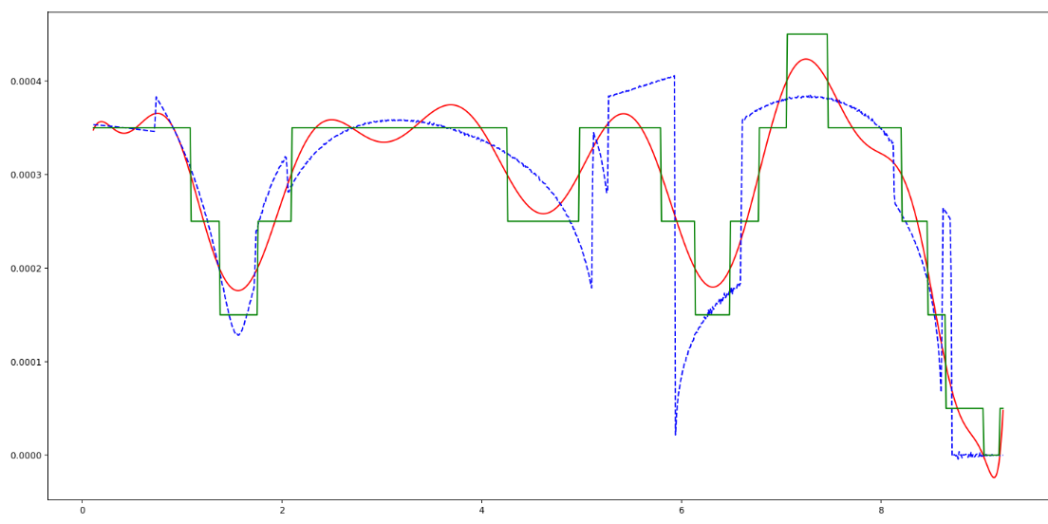
UI/UX
Visualization implemented with python (Pandas, Matplotlib)
Core visualization:
3. Variable histogram
Illustrates the distribution for each variable, could help understand the harvesting scheme better with the help with the feature importance score provided by random forest algorithm
1. Growth rate vs density plot
Includes the plot obtained from original data, plot predicted by polyfit, simplified function using step function
Gives clearer idea of the growth curve of algae, could provide better insights and proof for the solution.
2. Heatmap
Show the different combinations of three variables (density level, volume extracted, time interval). Includes both 2d and 3d heatmap.

Slide 10

Appendix

Slide 11
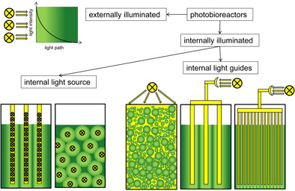
A1.1 Harvesting scheme
Algae is cultivated in a photobioreactor, where pH values, light intensity, concentration of K, N, P can be controlled. A photobioreactor (PBR) refers to any cultivation system designed for growing photoautotrophic organisms using artificial light sources or solar light to facilitate photosynthesis. PBRs are typically used to cultivate microalgae, cyanobacteria, macroalgae, and some mosses.
A harvesting scheme refers to a schedule where for each harvest, a fixed volume of solution containing the algae (Volume) will be extracted at a fixed solution concentration (density), and there is a fixed time interval between each harvest (time). By exploiting the optimal combination of these three factors, an optimal harvesting scheme could be used for maximum yield with automatic harvesting process.

Slide 12
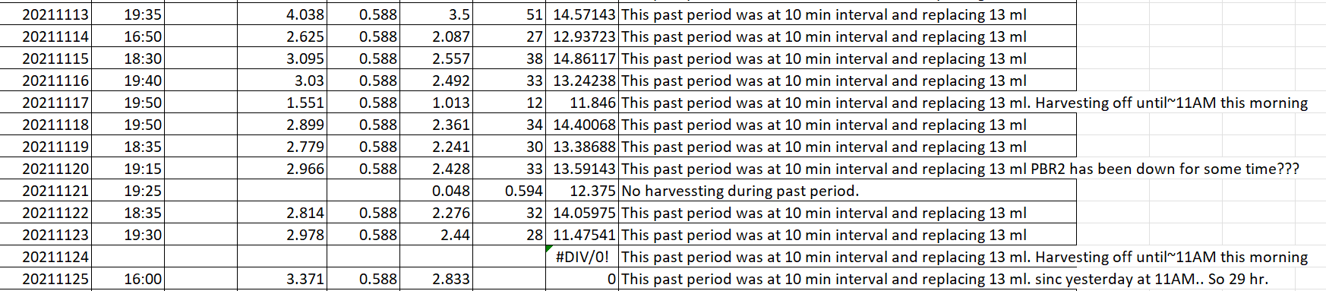
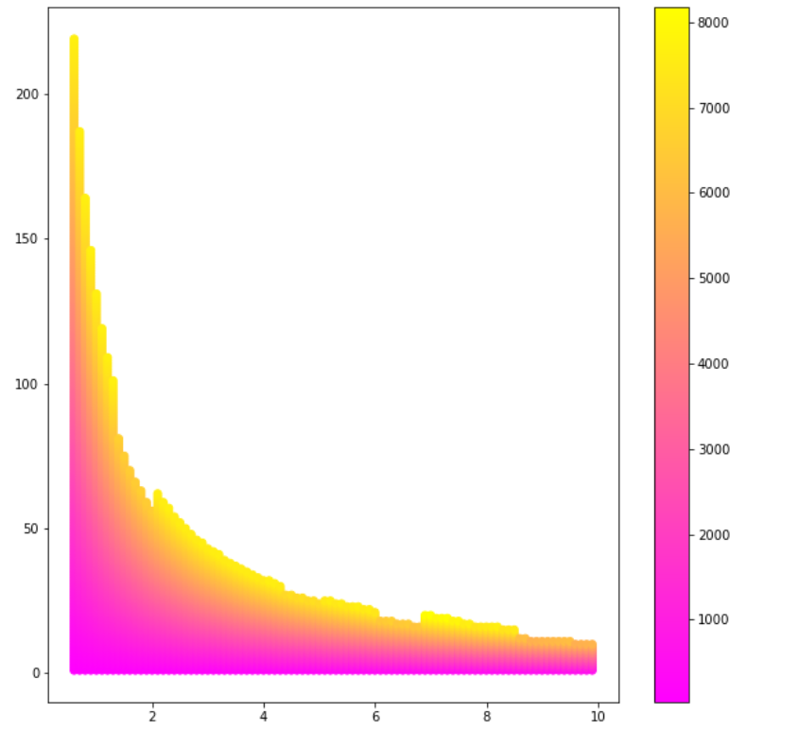
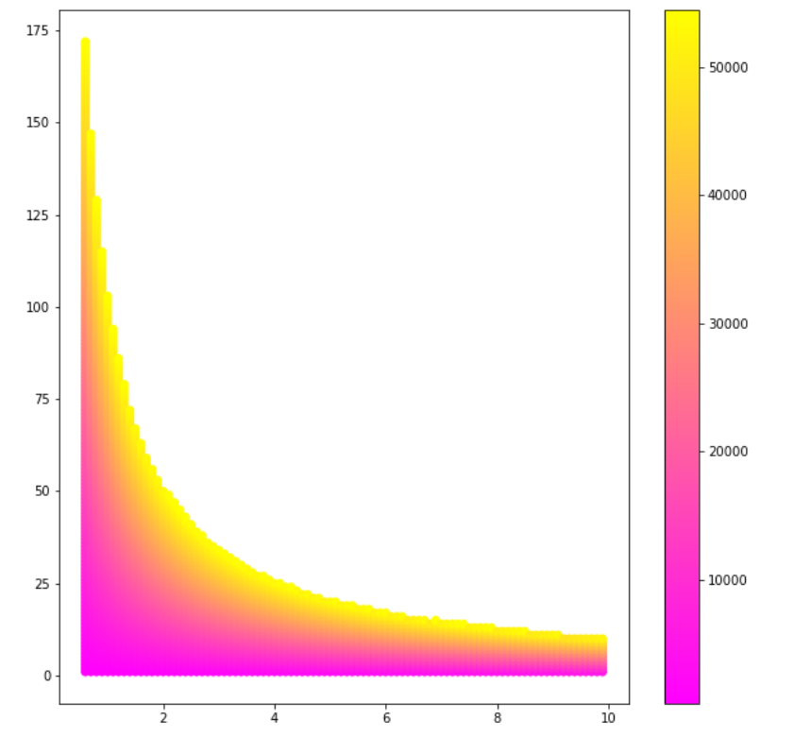
A1.2.1 Value Proposition
Quantitative Value Calculation:
Previous experiments done (before community capstone) by SVDC adopted a harvesting scheme of 10min time interval and 13ml volume. This result in a theoretical maximum harvest of 8000g per year (shown in Fig 1.2.1). Current optimal harvesting scheme could boost this yield to 52000g per year (shown in Fig 1.2.2)
Fig 1.2.1 simulation of original harvesting scheme, maximum output of 8000g dry algae
Fig 1.2.2 simulation of optimal harvesting scheme, maximum output of 52000g dry algae

Slide 13
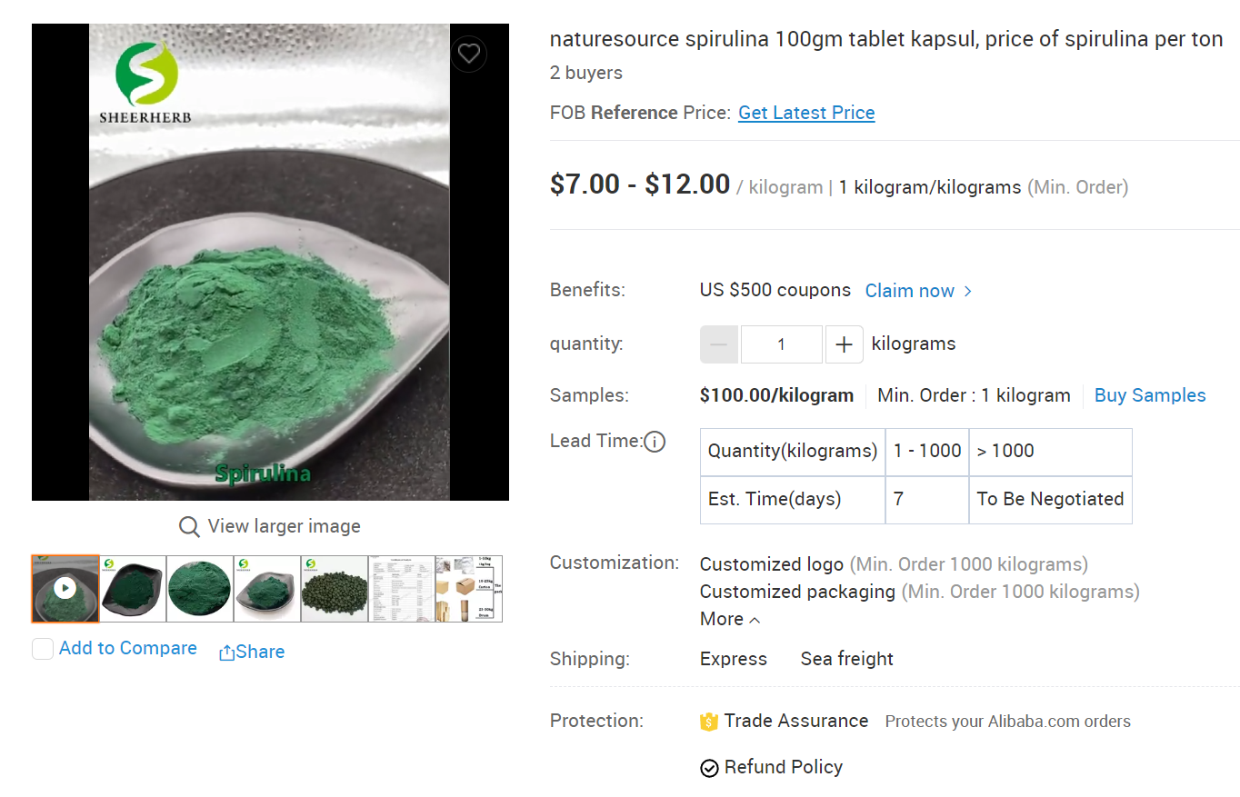
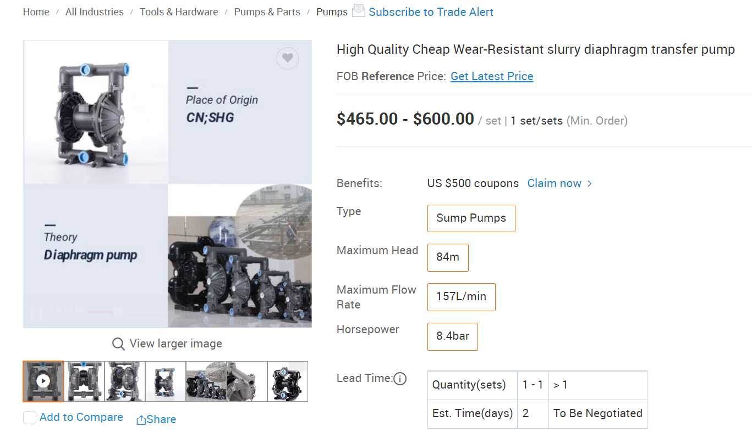
A1.2.2 Value Proposition – External Data
https://www.alibaba.com/product-detail/naturesource-spirulina-100gm-tablet-kapsul-price_1600316471504.html?spm=a2700.7724857.0.0.3bce63cf8HBoua
https://www.alibaba.com/product-detail/Pump-Diaphragm-Pump-High-Quality-Cheap_62345959753.html?spm=a2700.7724857.0.0.2d3f793565nTNF&s=p
Spirulina (the type of algae cultivated in PBR) is harvested in the form of dry powder, and the current market price from competitors is around 7 dollars according to Alibaba. Therefore, $7 will be used as a reference and profit made will be calculated according to this value. However, this value could be adjusted in the model according to the variation in the market.
The cost for each harvest considered in the improvement part covers the wear of the pump, as the harvesting process is completely automatic. Assuming a pump could work for 5000 times, the average cost for each harvest will be around $0.1. This value is for reference only and can be easily adjusted in the model as well.
The expected improvement in yield can be calculated by (52000-8000)/8000 = 550%. And the increase in profit for a 1000L PBR will be 44000*7/1000*100 = $30800.
The yield is based on a 10L PBR, and in the unit of grams. Therefore we need to divide 1000 to convert to kilogram and multiply by 100 to scale it up to 1000L PBR.

Slide 14
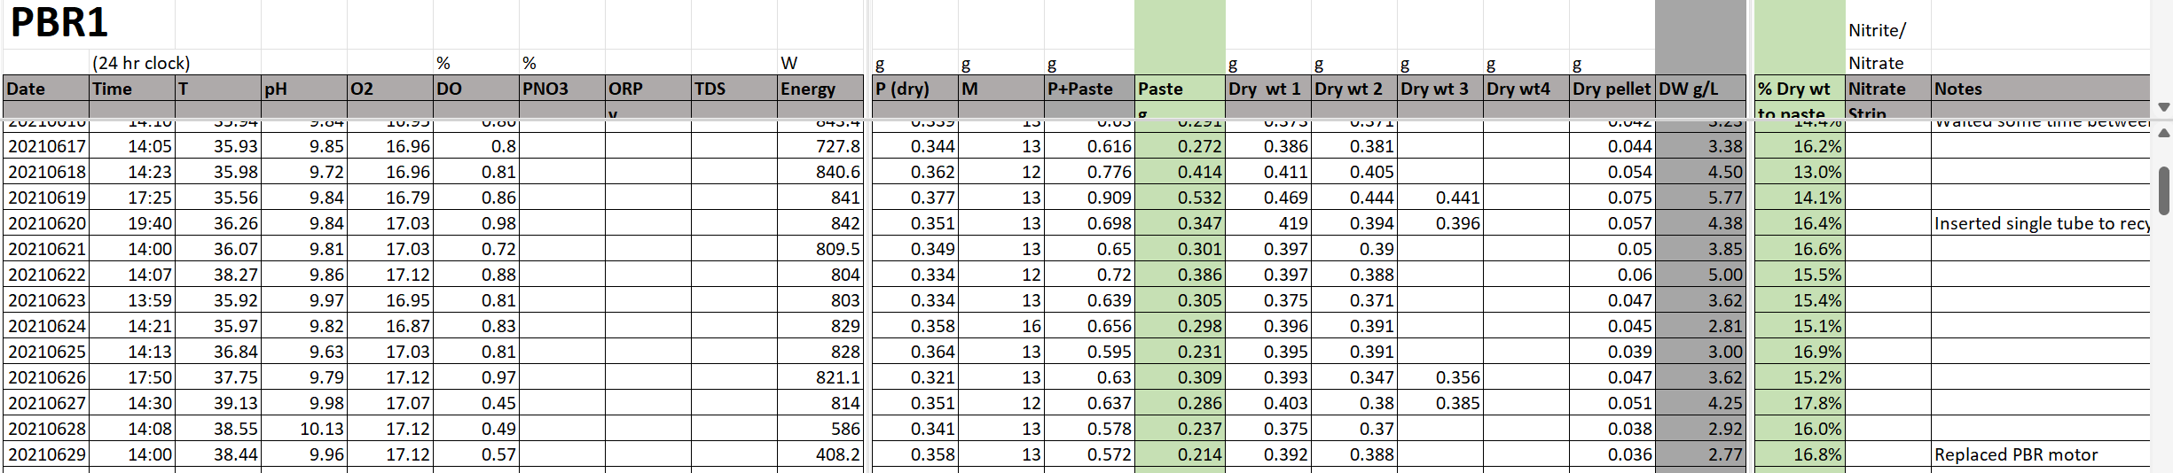
C.1.1 Internal Dataset – PBR1 dataset
PBR dataset containing many information, however most of them will not be useful as the environmental factors such as Temperature, pH, O2 and etc are not considered in the theoretical optimization model. The only useful columns are the date and DW g/L, which corresponds the density of the solution.
Limitations:
As the environmental factors are not controlled, the environment could pose effects on the growth of algae. For example, the pH value of the environment is controlled by a carbon dioxide pump. During 2021, there were malfunctions of the pump, causing the pH value went very basic for a period. These factors could lead to unreliable growth cycle.
Frequent tests on different harvest scheme posed challenges on the exploration of complete algae growth cycle. It is very difficult to find a period where the growth was not disturbed by any external activities.
The density calculated can be affected by the operation as some of the records stated that sample was burnt, leading to an unreliable record in that day.
Assumption:
The environmental factors do not play an important role in the growth cycle, assume they maintain constant or poses little influence.
Assume each harvest will have no cost, considering the mass harvested instead of the profit made.

Slide 15
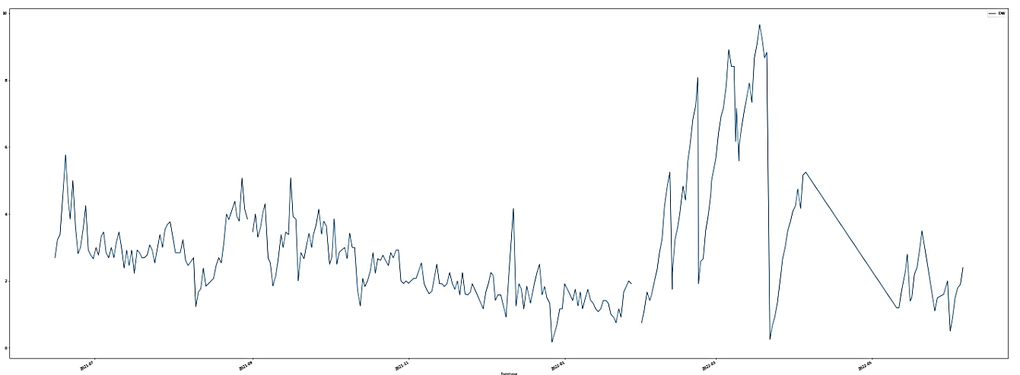
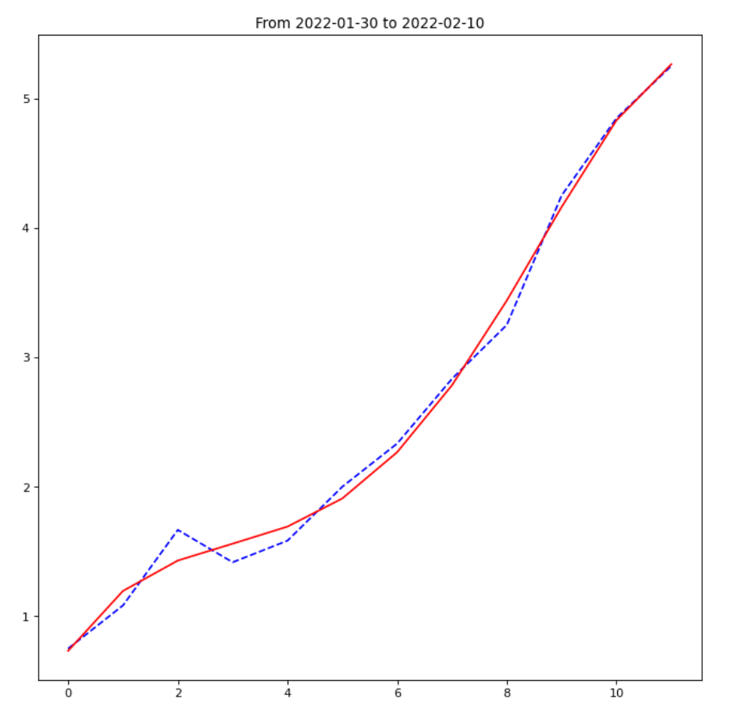
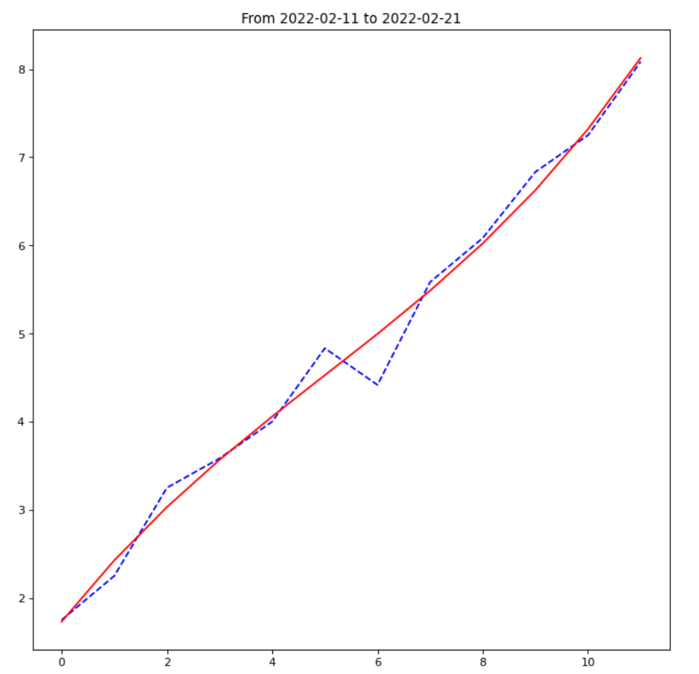
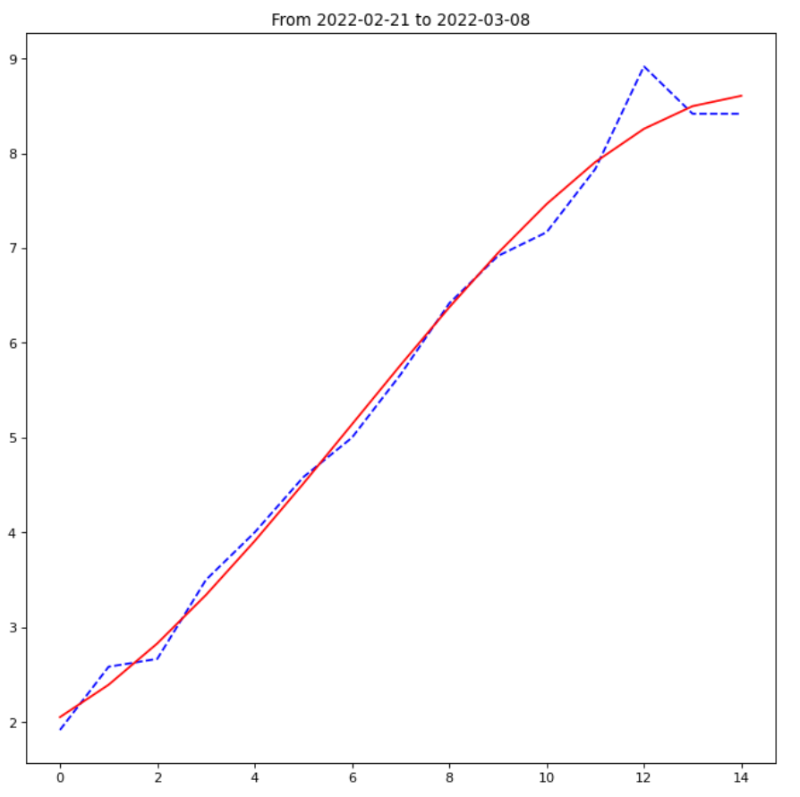
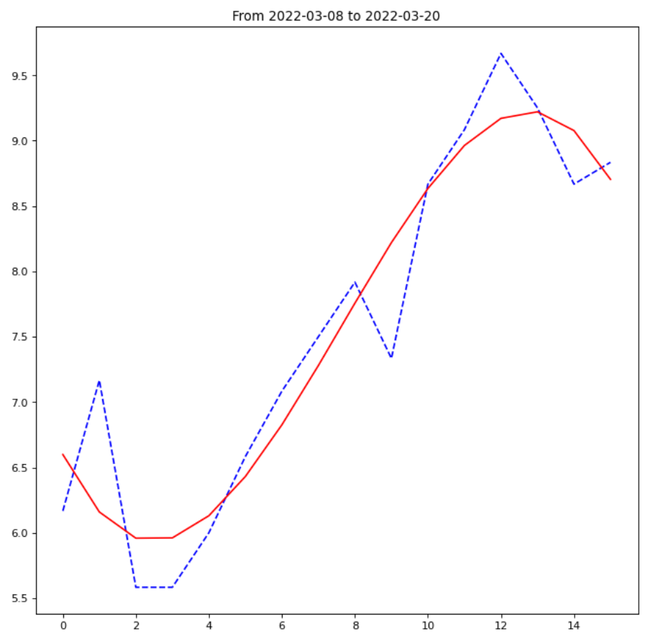
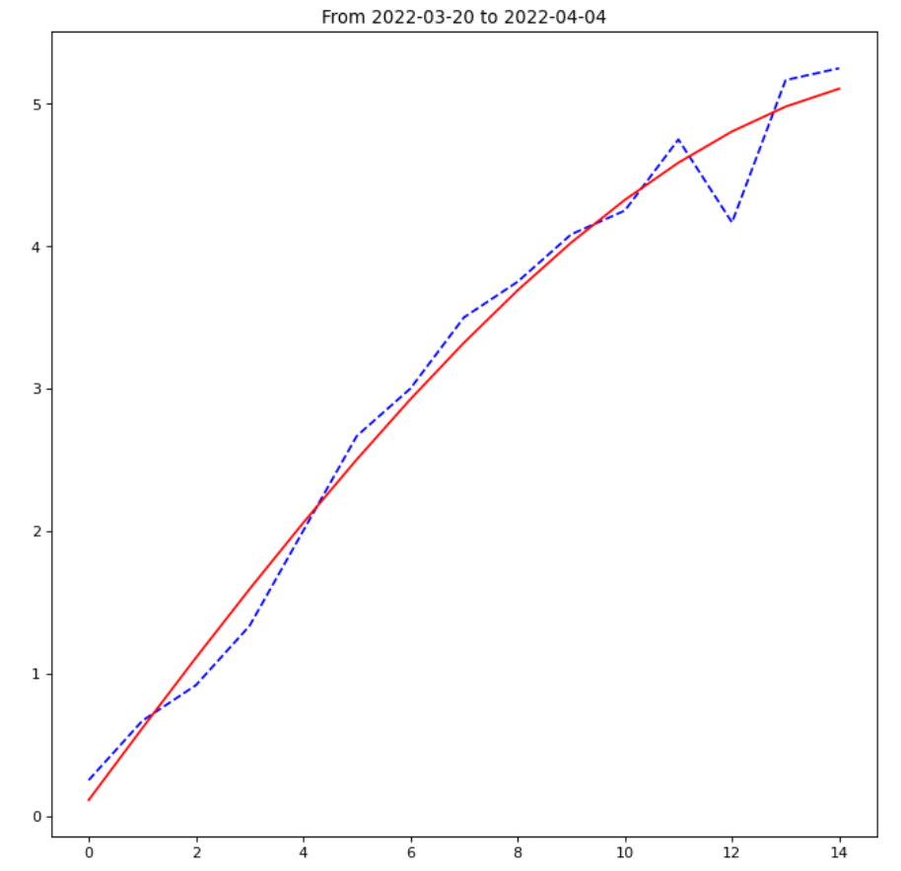
C.1.2 Data Selection
most of the data is affected by the daily harvest therefore we will only choose the period that is not affected by frequent harvests. Therefore this section is chosen and only few harvest are conducted. There are several harvest/ split happened on:
- 2022-02-11: remixed, new start
- 2022-02-21: split 4L and start 3rd trial
- 2022-03-08： replaced 3144ml media
- 2022-03-20: harvest all
- 2022-04-04: full harvest
Density vs time plot
Blue dashed line is the original datapoints, where red line is predicted by polyfit() function in degree 3, fitting a S-shape curve according to the research result of SVDC.

Slide 16
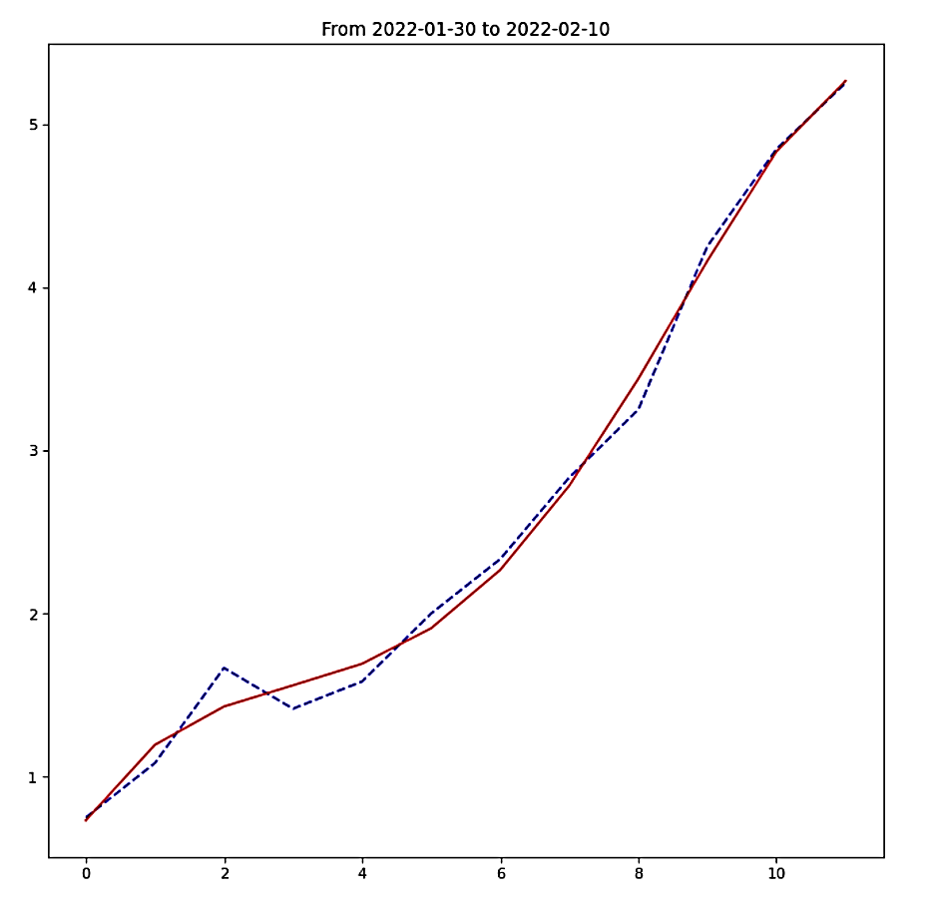
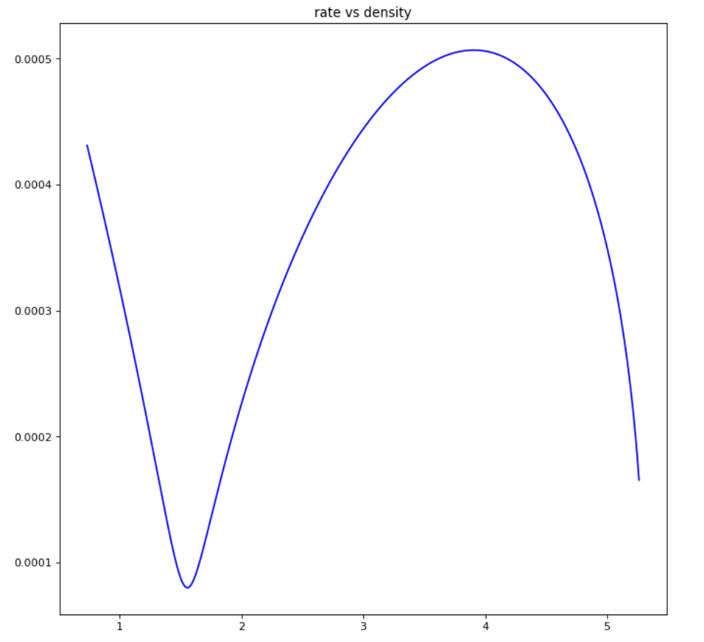
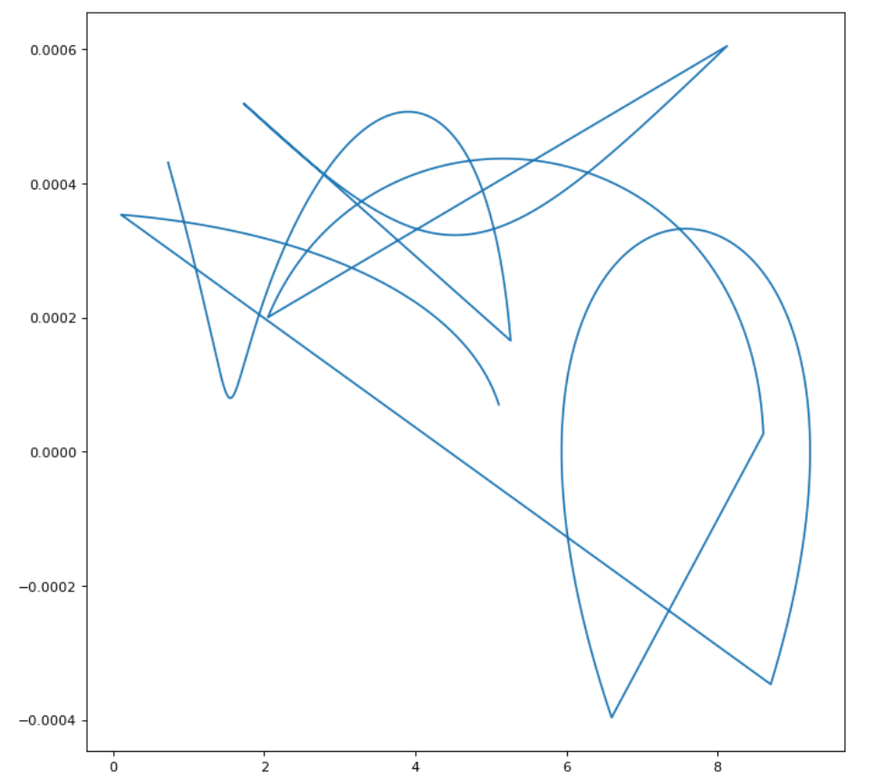
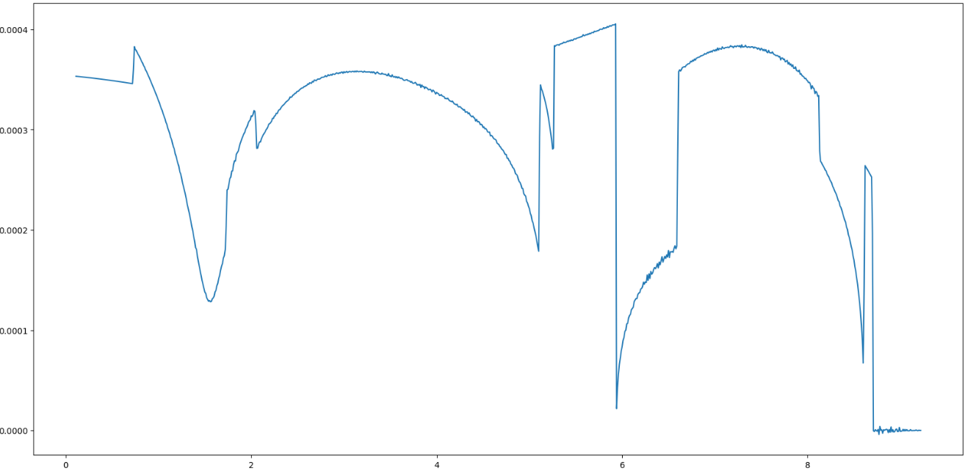
C.1.3 Growth Rate Calculation
growth rate will be determined based on 1 min, instead of on a daily basis. Therefore, discrete data points with daily frequency cannot meet the demand, and continuous fitting functions provided by polyfit() can complete the task. By creating a fitting model, it can return the predicted density on any given time.
The red line is the continuous fitted curve provided by the model. Therefore, we could divide out minimum unit of day into minutes. (1 day = 1440 minutes)
1 minute = 1/1440 day;
current density = model(t) ; density after 1 min = model(t+1/1440)
growth rate per min = (model(t+1/1440)-model(t))
The rate vs density for one cycle
The rate vs density with five cycles combined
The rate vs density plot after calculating mean for each density and performed winsorization

Slide 17
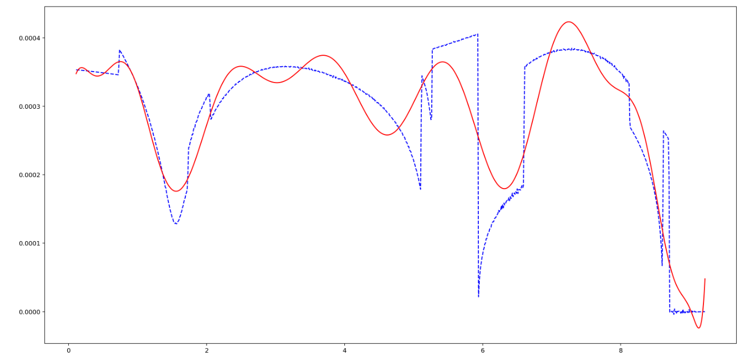
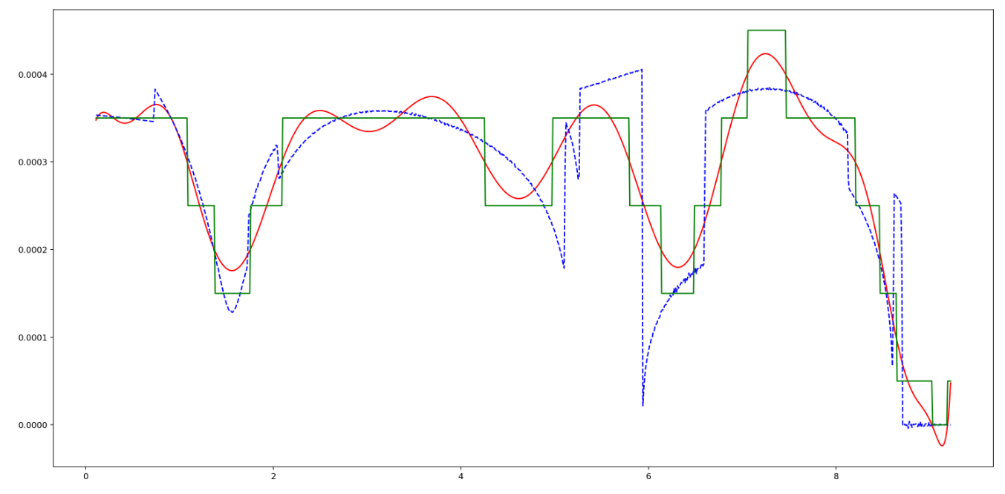
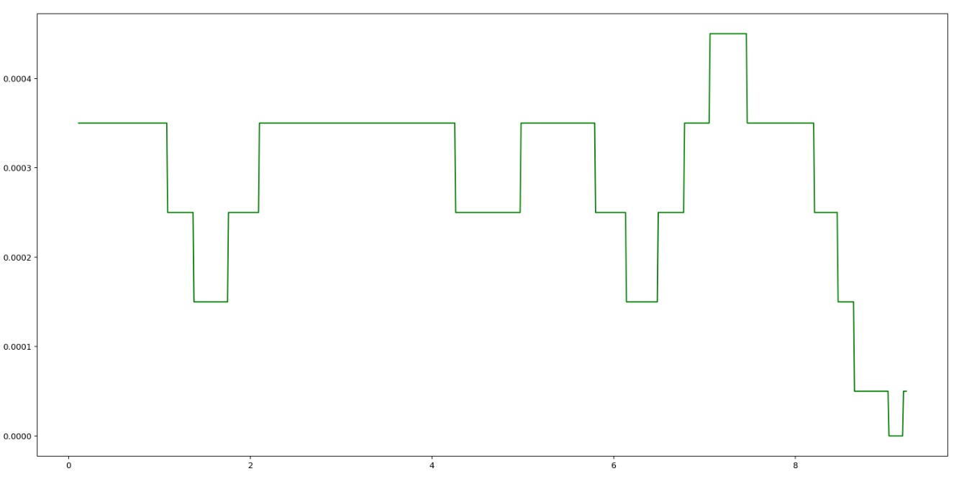
C.1.4 Simplification of the growth rate vs density plot
In the iteration, we need to find the time for the solution density to grow back to the target level after harvesting (i.e. density will decrease after harvesting. Time for the solution to grow back to the original target level.) If growth rate vs density function is constantly changing, it will pose great burden on the computation power, taking 11 days to iterate through all the possibilities. By mimic the function using step functions, we could tell the growth rate by finding the range instead of constantly computing using the polyfit() model.

Slide 18
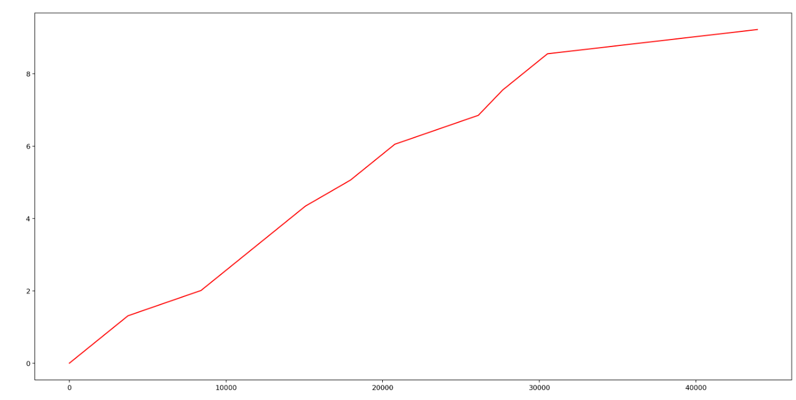
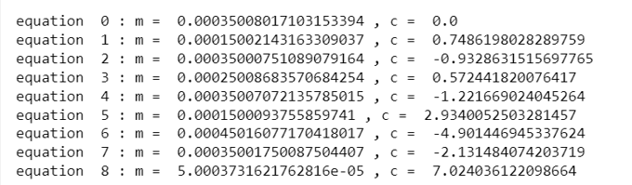
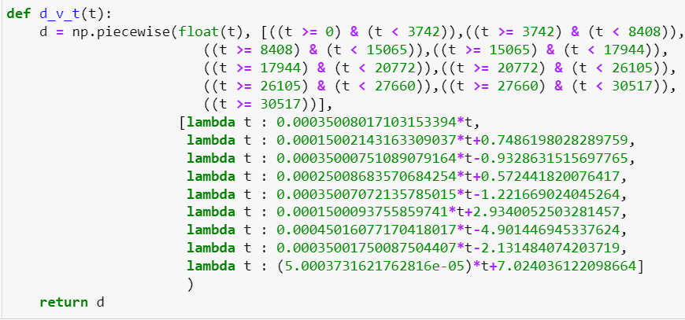
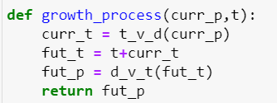
C.1.5 Density vs time growth function
By considering the growth rate at different density, we could calculate the time required to reach certain density from time = 0s. By calculating the density level and time at turning points of the growth rate vs density plot, we could use a piecewise function to represent the simplified growth cycle of the algae. For the system in PBR to grow from 0 density to 10g/L (maximum density, after that algae ecosystem will fail due to various reasons), it will take approximate 45000min, equivalent to 31.25 days.
The growth_process function will be an important function calculating future density. By entering a current density level and a time period t, it will return the density level after time t. It will be used to check if one random combination of solutions is actually feasible or not. (if after time t, the density level cannot grow back, then it is not feasible)

Slide 19
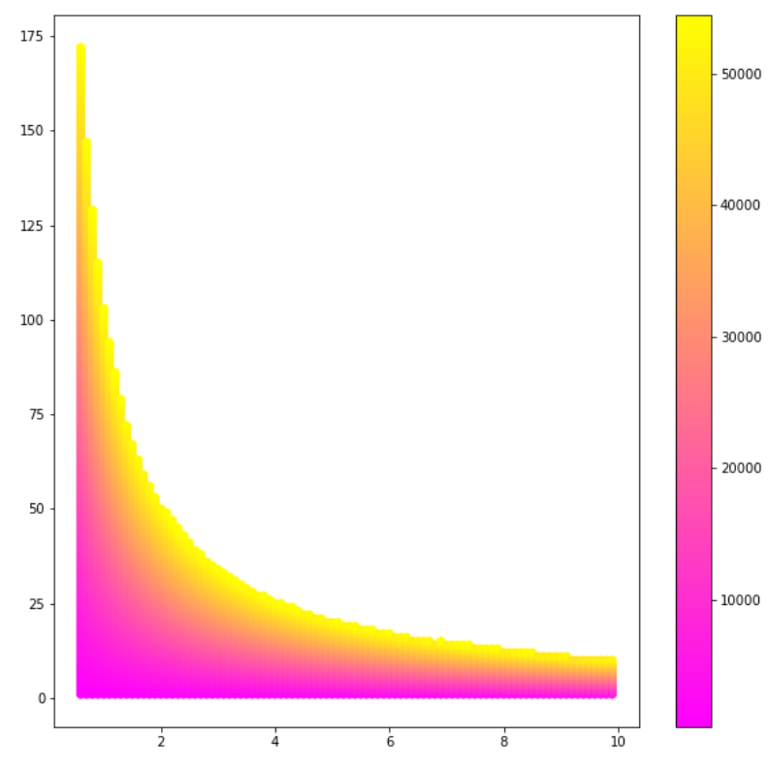

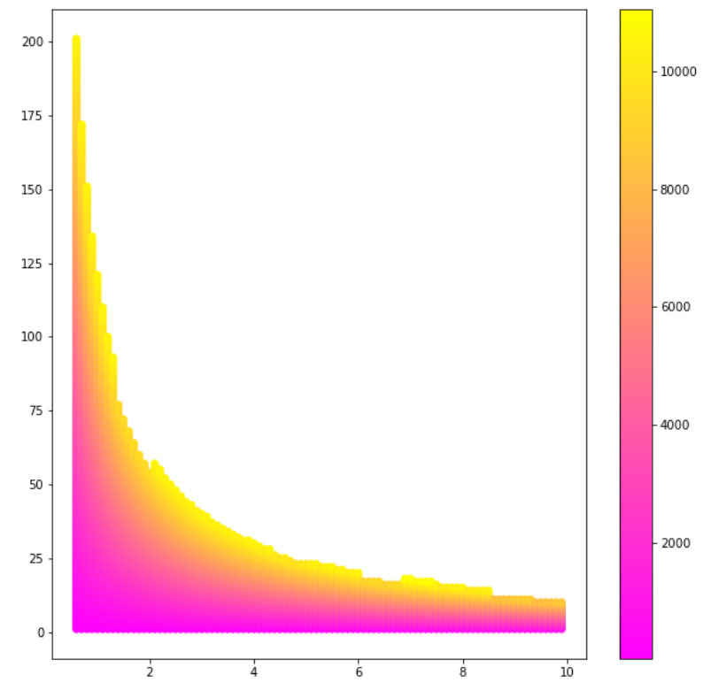
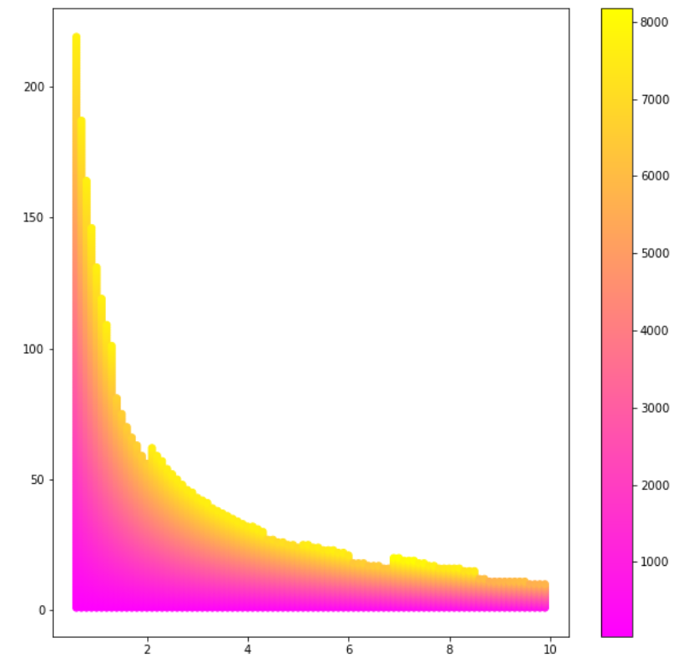
C.2.1 Small t value exploration
Conclusion:
1. no matter the value of the time interval t, for those harvesting schemes with highest yields, their density and volume always follow an inversely proportional relationship.
2. As the value of t becomes bigger (longer interval), the maximum expected yield dropped dramatically, following an exponential relationship.
Since the iteration heatmap method can hardly give any details due to its large coverage, heatmap generated specifically for small t values (t = 1, t = 3, t = 6, t= 9) are generated to see the change in the yield with respect to the increment of time.
t = 1 t = 3 t = 6 t= 9

Slide 20
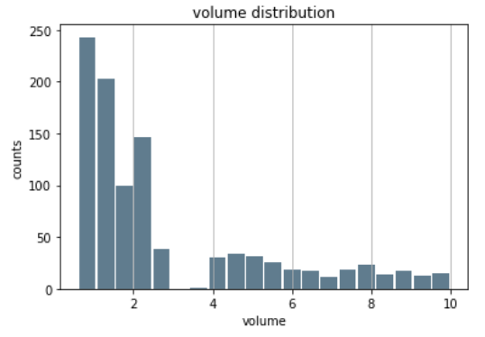
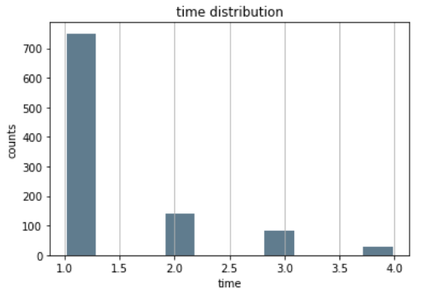
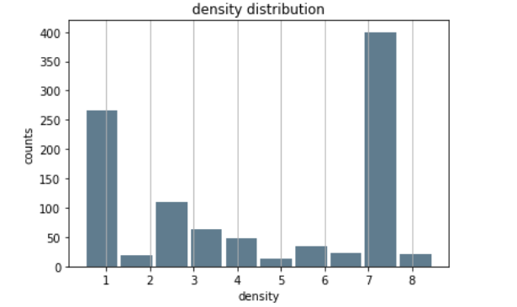
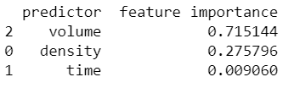
C.3.1 Random Forest Regression
When considering harvesting at zero cost, the density, time and volume distribution is shown below
Time has the lowest feature importance because it seldom varies. Volume for each harvest is low and density focuses at 1g/L and 7g/L, indicating possible harvest interval.

Slide 21
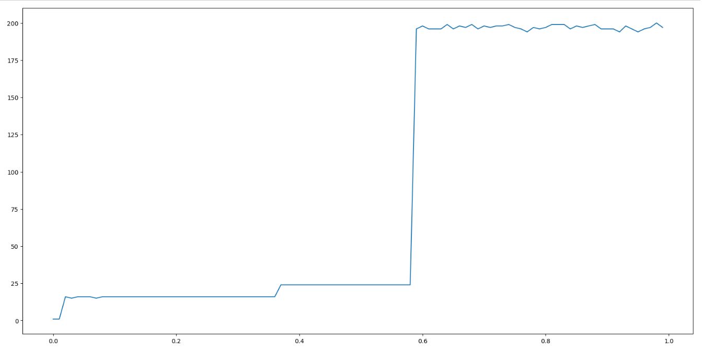
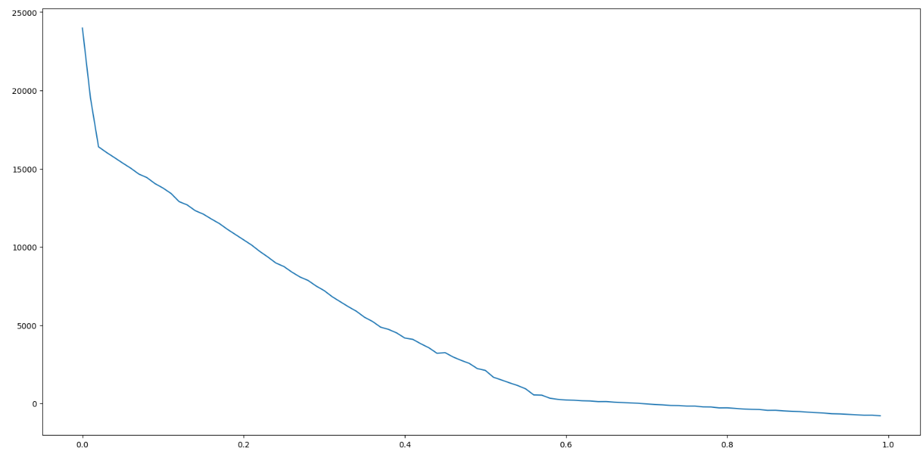
C.4.1 Improved optimization model
After introducing cost, the harvesting scheme pattern changed dramatically. The following plots shows the time interval and profit made in the optimal harvesting scheme with respect to the cost per harvest. (optimal time vs cost & optimal profit vs cost)
In the time vs cost plot, we could see that in the only there is little cost in harvesting can a scheme choose to harvest at maximum frequency (low t value). Once the cost increases by a little, the time interval surged to around 20min, and maintains until the cost per harvest increases to $0.6, after that the time jumped to 200min between each harvest. This is because the price of the algae is $7/kg, the increasing cost leads to a decreasing profit margin.
In the profit vs cost plot, we could see that the theoretical maximum profit drops quickly at the beginning, meaning once there is cost, there will be a big difference in profit made. Therefore, theoretical maximum profit/ output can only be used as reference because in reality, cost is inevitable.

